Slide 1

Cost-effectiveness in social interventions
Feb 13, 2023

Slide 2
Outline
What is cost-effectiveness?
Why should we care about it when evaluating social interventions?
How much does cost-effectiveness vary across social interventions?
  Anecdotal evidence
  Systematic evidence
  Survey estimates
Takeaways

Slide 3

What is cost-effectiveness?
A way of conceptualizing and measuring the amount of some x produced per dollar.
This is useful when we want to quantify something (perhaps in order to optimize it), but our outcomes are not naturally in dollars.
One example: we can use quality-adjusted life years (QALY) to compare health interventions.

Slide 4
Why should we care about cost-effectiveness?
We naturally (usually informally) care about cost-effectiveness in our personal lives.
  We might benchmark phones by a set of features per dollar.
  We might benchmark apartments by bedrooms per dollar.
We do this in order to not waste money, or because we want to maximize the “bang for our buck.”
The argument for caring about cost-effectiveness in social interventions is the same.
Notes:
See Ord for more: https://www.cgdev.org/sites/default/files/1427016_file_moral_imperative_cost_effectiveness.pdf

Slide 5
How much does cost-effectiveness vary across social interventions?
This can be hard to quantify, but we have some rough informative evidence.
Before showing that evidence: what do you think?
  Imagine two charities. Charity H has the highest cost-effectiveness, and charity A has average cost-effectiveness.
  How much higher in cost-effectiveness is charity H than charity A?
Notes:
The right answer is probably about 100x, but it could be between 50-100x. It is very unlikely to be e.g. 2x

Slide 6
Evidence on the distribution of cost-effectiveness

Slide 7
Anecdotal evidence
Suppose we have a $40,000 budget which we can spend as we wish to fight blindness.
Cost to provide guide dogs to blind people in the United States to help them overcome their disability is about $40,000 because of the training required for the dog and its recipient.
Cataract surgery to restore sight costs about $1000.
If we think that people have equal moral value, then the second option is about than 40 times better than the first.
Notes:
Ord gives a more extreme example but I don’t trust his numbrers: https://www.cgdev.org/sites/default/files/1427016_file_moral_imperative_cost_effectiveness.pdf
I used the less extreme example from GWWC https://www.givingwhatwecan.org/charity-comparisons

Slide 8
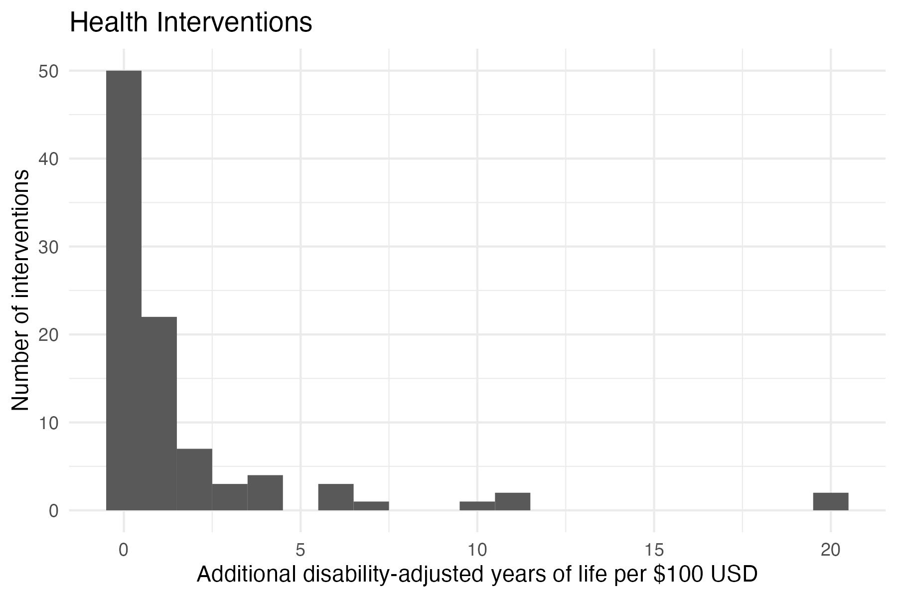
Health evidence
Data from Disease Control Priorities in Developing Countries, 3rd ed. (DCP3)
Extremely skewed distribution!
  Median is 0.44
  Mean is 1.75
  Best intervention is 20
Treat severe malaria with artesunate
Notes:
“Disease Control Priorities in Developing Countries”, which includes a collection of cost-effectiveness estimates using DALYs
Email me at rbriggs@uguelph.ca and I can share the data and script that made these graphs
All three of these datasets were originally flagged here: https://stijnbruers.wordpress.com/2021/03/18/cost-effectiveness-distributions-power-laws-and-scale-invariance/

Slide 9
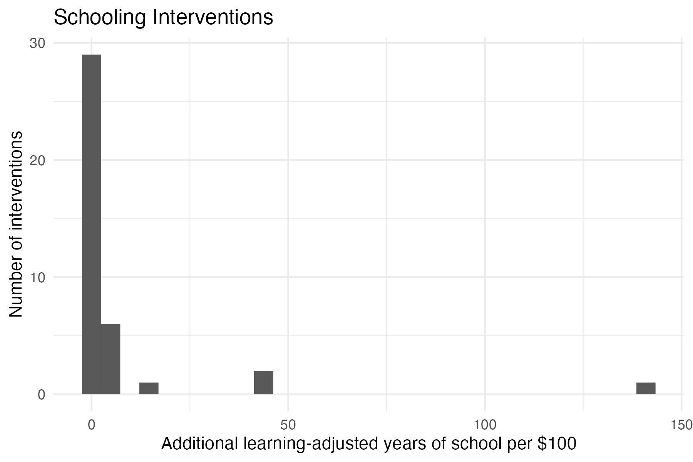
Education evidence
Data from 2020 World Bank report
Extremely skewed distribution!
  Median is 0.82
  Mean is 7.4
  Best intervention is 141
Provide students with targeted information on future earnings
Notes:
“How to Improve Education Outcomes Most Efficiently?”, WB Policy Research Working Paper 9450

Slide 10
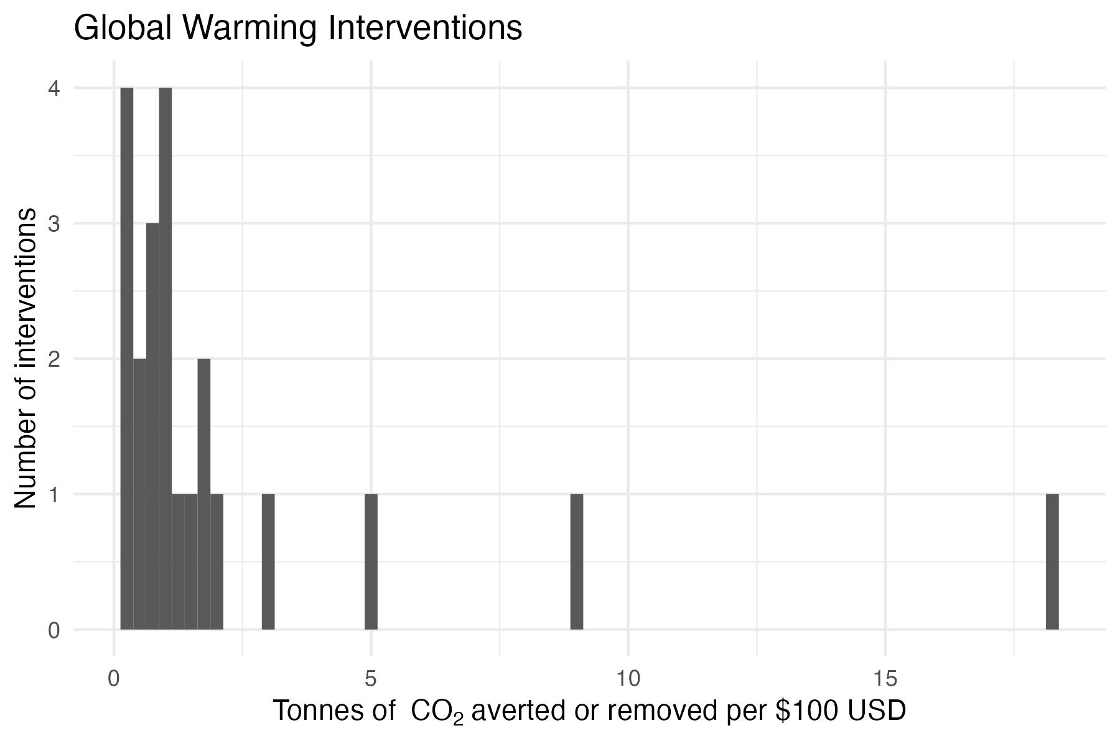
Environmental evidence
Data from 2018 Journal of Economic Perspectives article
Extremely skewed distribution!
  Median is 1
  Mean is 2.4
  Best intervention is 18
Reforestation
Notes:
“The Cost of Reducing Greenhouse Gas Emissions” in JEP by Gillingham and Stock
Even in this less extreme case, the difference between the middle intervention and the most-effective one is 5-fold!
And this is before we even consider the bottom half of interventions

Slide 11

Survey evidence
Question: How much more effective is the best charity as compared to an average one?
What is your guess?
In surveys:
  members of the public think the answer is around 2x.
  Experts in cost effectiveness think it is around 100x.
Notes:
From: https://journal.sjdm.org/20/200504/jdm200504.pdf

Slide 12
Caveats
Less-studied interventions will likely exhibit regression to the mean. This would likely compress the prior distributions somewhat.
  This is one reason to read literatures and not single studies. The health evidence is least susceptible to this form of bias.
Many things that are highly cost effective are not that effective in absolute terms but are very cheap to implement, like sending text messages.
Cost-effectiveness is unlikely to be linear in funding. If you start funding something heavily, its cost effectiveness will probably go down.
We don’t have cost-effectiveness estimates for things where CE is hard to measure. Would adding these increase or decrease the range or skew?
Notes:
This is very rough. It is hard to precisely nail down cost-effectiveness in this context.
Regression to the mean: less studied, noisier (statistically) interventions might look really good because we pulled an atypically effective draw from the hat. If we did more draws they would likely look worse.
CE is harder to measure in big macro things like building a health system. It’s unclear if this would make the cost-effectiveness estimates more or less skewed, but we should be careful that we’re thinking clearly about the universe of interventions, and not only focusing on the ones where measurement and causal inference is relatively easy.

Slide 13
Discussion
Even given the caveats, cost-effectiveness in social interventions seems more variable than what we usually see in our normal (market) interactions.
  Perhaps this is because social interventions typically lack the information and accountability mechanisms of markets.
Merely doing or funding the median social project implies that you are leaving most of your possible impact on the table.
  In the global health case, funding the best intervention for $100 does the same good as giving the middle intervention $4,000.

Slide 14

Take aways
The distribution of cost-effectiveness in social interventions has a very wide range and is highly skewed
The value of information in this space is very high!
There is a moral argument for caring about cost-effectiveness (Ord).
  Choosing less cost-effective measures is equivalent to donating less at a given cost-effectiveness.
  Under some moral views, we are obligated to pick more cost-effective measures.
Notes:
Of course, half of all interventions are below the median!
Using the DCP3 numbers, for $100 you could avert 20 DALYS with the most effective intervention or about 0.5 DALYS with the median intervention.
For more on the moral argument, see Ord: https://www.cgdev.org/sites/default/files/1427016_file_moral_imperative_cost_effectiveness.pdf

